Slide 1
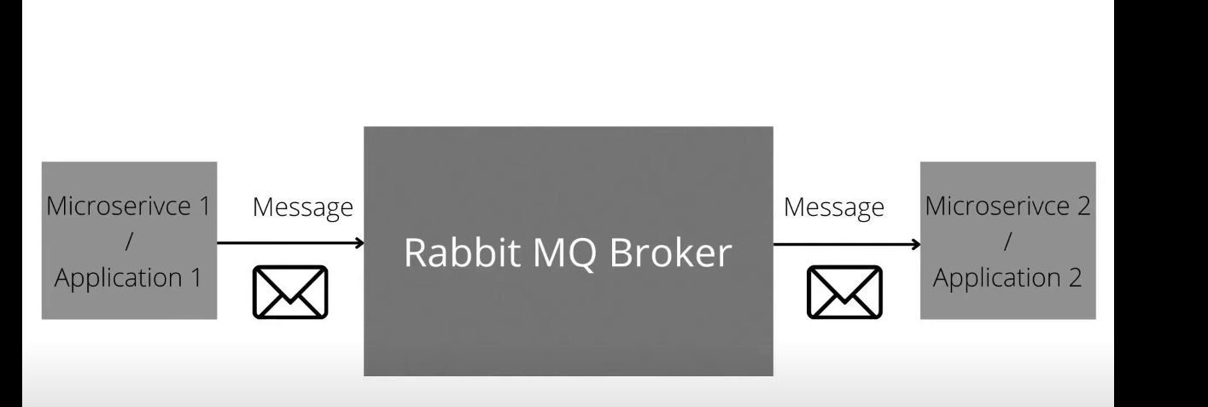
Rabbit mq is man in middle

Slide 2
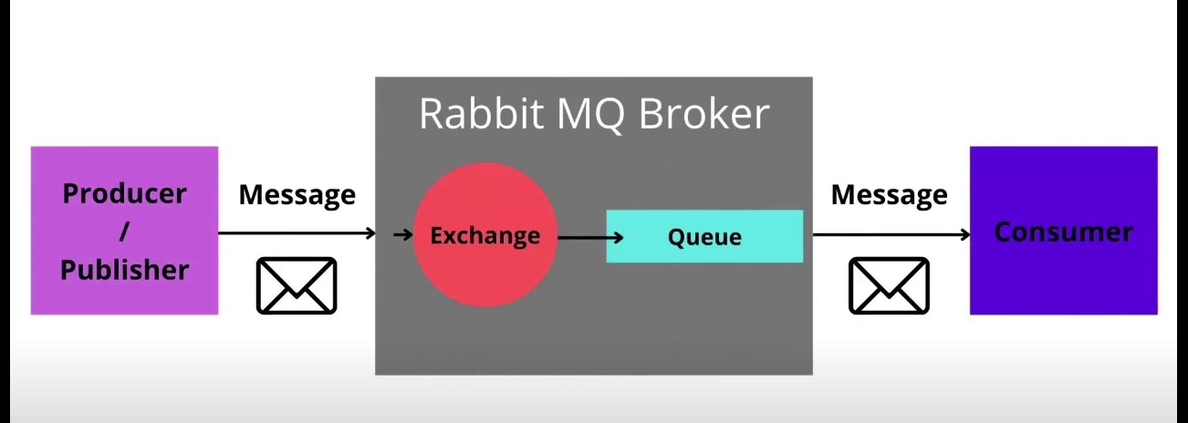

Slide 3
process involved
1. producer produces message to the mq broker
2. Rabbit mq consist of exchange and the queq
i). role of the exchange to route that message to the specific route
ii). as soon as message come to queq consumer will consume it
iii). Consumer listens to the message

Slide 4
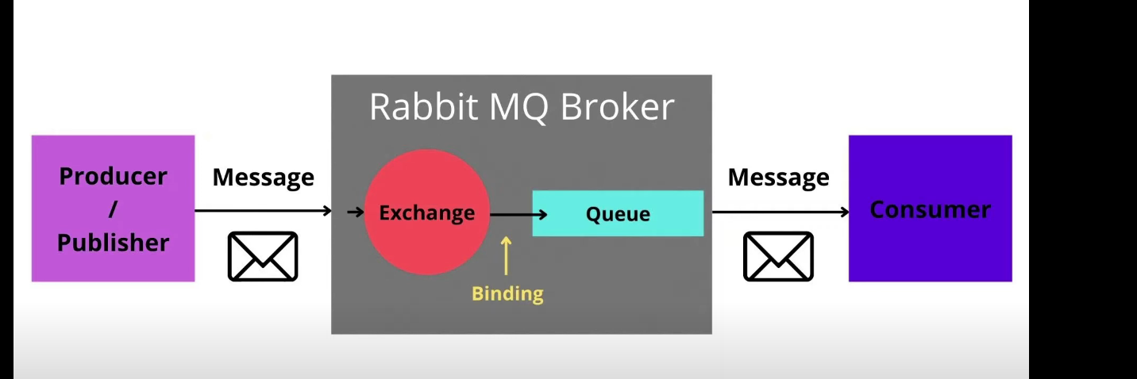

Slide 5
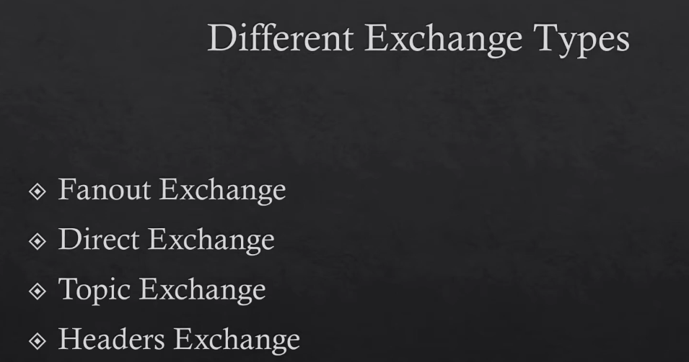

Slide 6
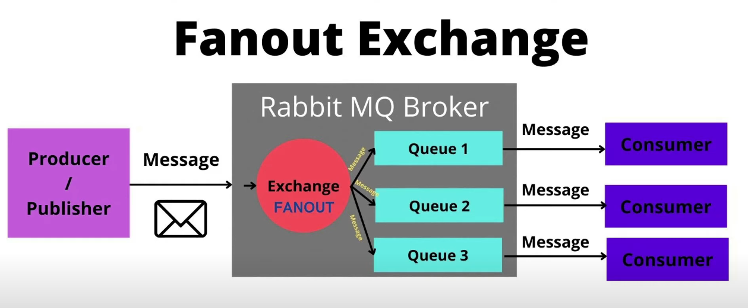
Message is delivered to every single queque (broadcast type)

Slide 7
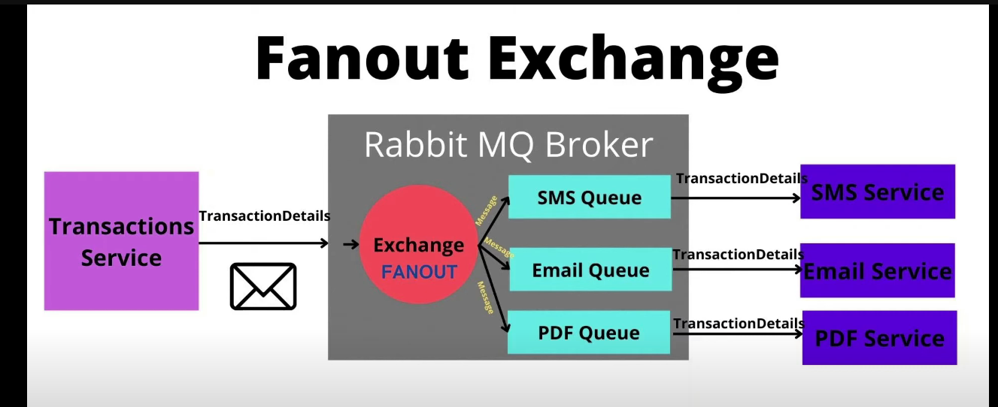

Slide 8
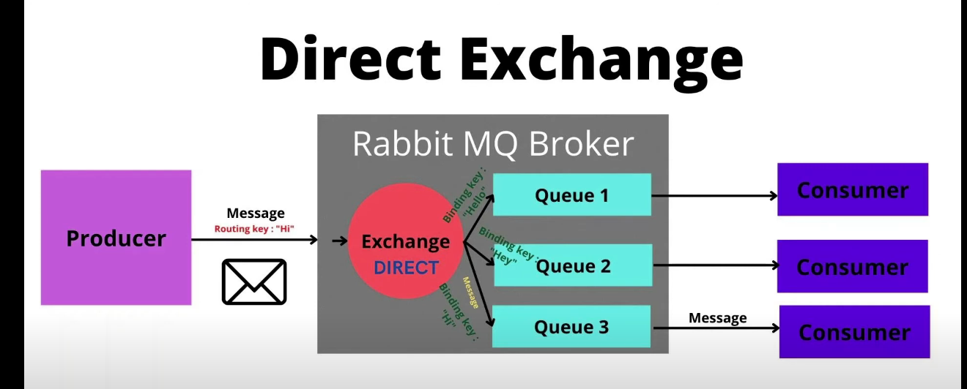
routing key :{hii} binding key:{hi} roting key is matched with binding key

Slide 9
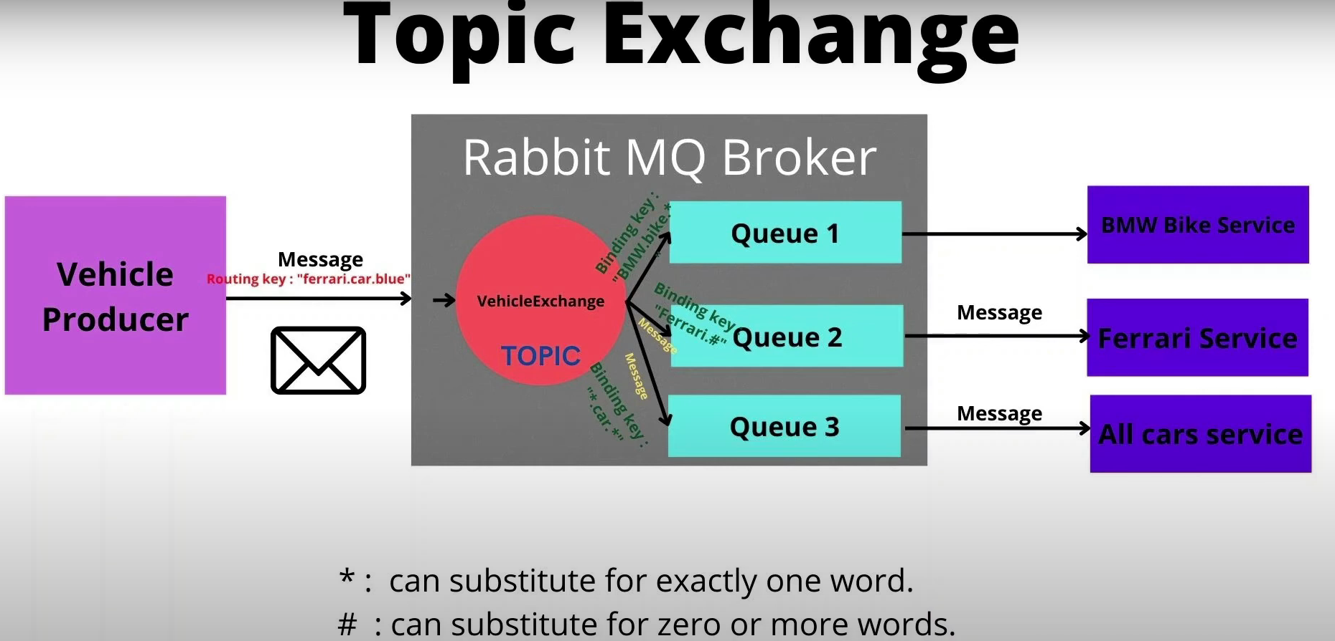
Ferrari.car.blue brand.vehicle-type.color

Slide 10
* # is the wild card characters
zoom and look at binding keys
BMW.bike.*
Ferrari.#
*.car.*
Our routing and binding keys are case sensitive
Case is mistaken in our picture ignore it

Slide 11
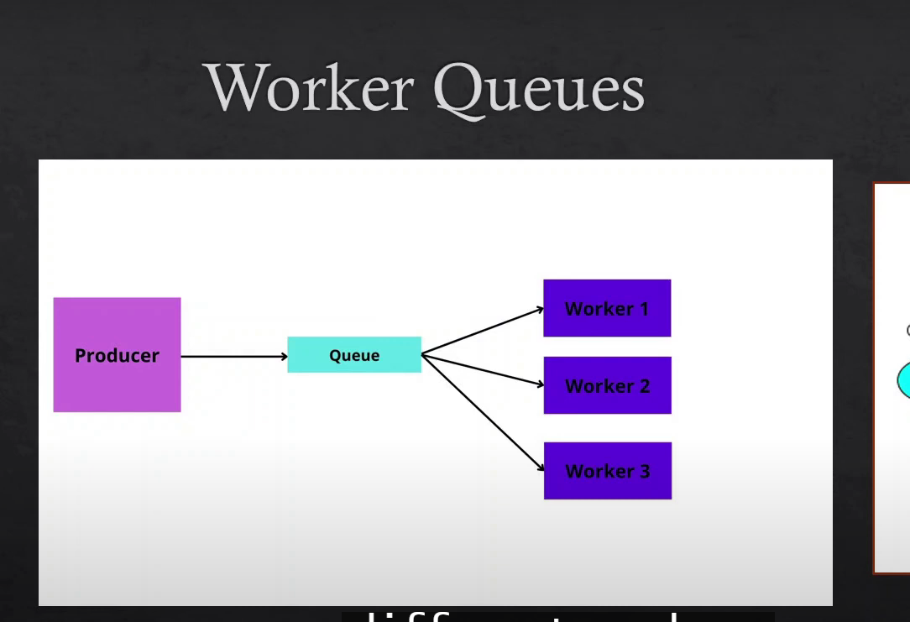
worker queques is used to distribut a task in different workers

Slide 12
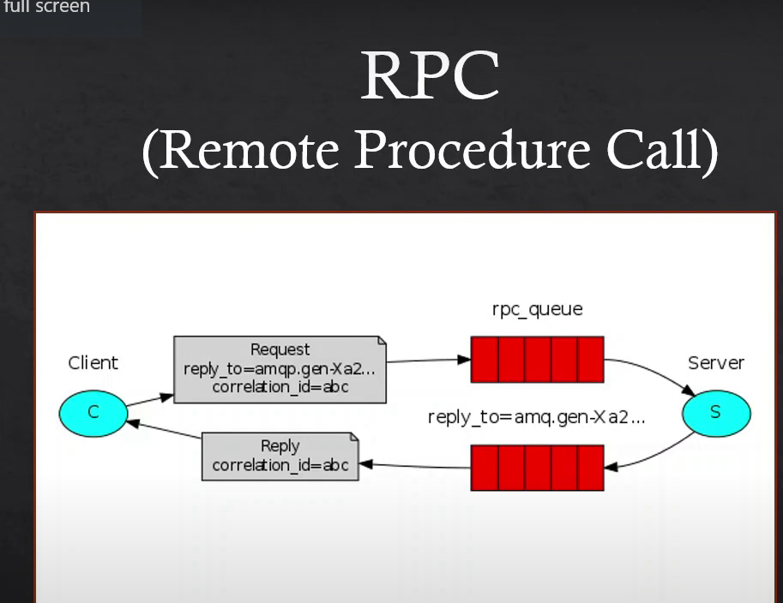
We wait for response

Slide 13
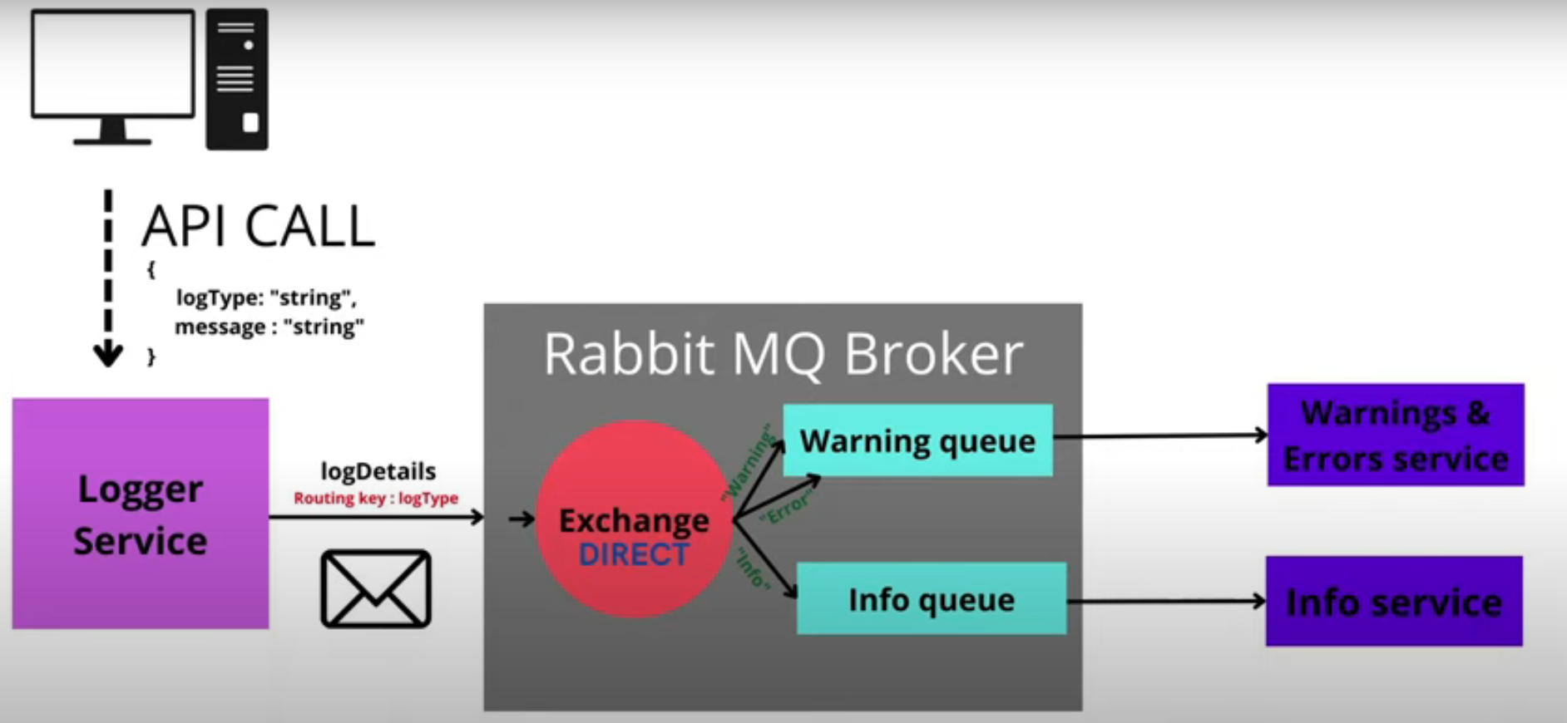
Project overview logtype is info

